Slide 1

High Value Clients (HV Clients)
Updated 8.17.23
Who is considered a High Value Client
  Clients enrolled with debt balances of $60,000 or more
How does a High Value client differ from any other client?
  In effort to track the success of our high enrolled debt clients we will have a specific group of teammates assigned to High Value skills for both inbound and dialer campaign outreach efforts to complete their welcome call and guide them through their successful first draft.
  Our High Value inbound skill is a prioritized skill, therefore, if a client calls in on that number, their call will be prioritized.
  All clients will continue to get our premium client experience, however, for better tracking of client needs for these high enrolled debt clients, we will route them to prioritized skills.
Anything else we should know?
  This process is for COA, Affiliate, and Attorney Model Clients
  These clients are all loaded into our High Value dialer skills however, sometimes, you may be asked to manually contact one of these clients.
  When speaking to an HV client, always be sure to provide them the HV inbound number.
    COA Client – 443.401.4399
    AM Client – 443.563.1755

Slide 2
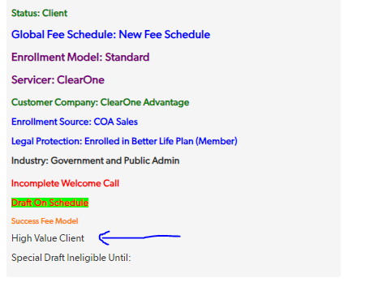
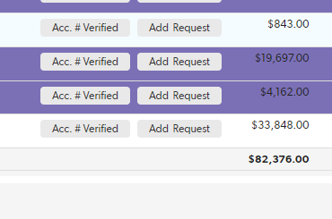
High Value Clients (HV Clients)
Updated 8.17.23

